Slide 1

To Settle or Not to Settle: Predicting Outcomes of the Federal Courts
2020
MUDAC 2020 | Team 38

Slide 2
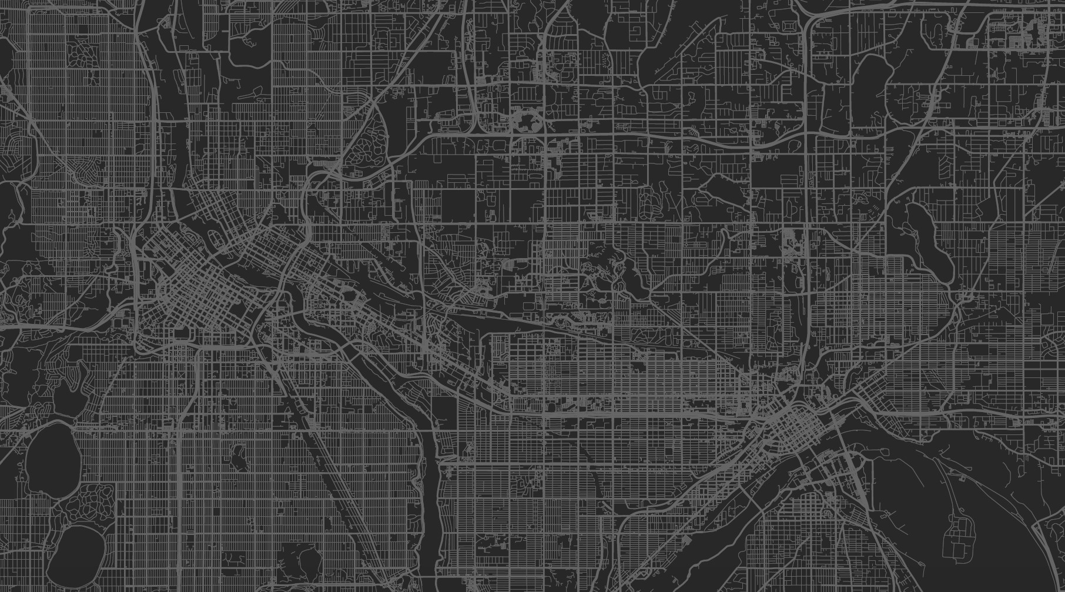
The Background
MUDAC 2020
How do demographics shape our judicial system?
What are factors that change judicial decisions?
Are courts biased in decision making?
How can courtroom decisions be accurately predicted?
What is the goal?

Slide 3
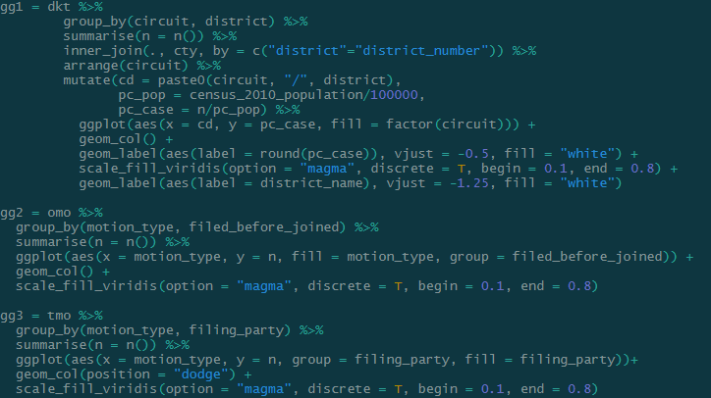
The Data
MUDAC 2020
Case Data from Circuits 6, 7, 8
Motions Filed
Location Data
Demographic Data from governing.com
Ethnicity and Race Data by State
Median Income Data from worldpopulationreview.com
What were we given, what did we find, and how did we use it?

Slide 4
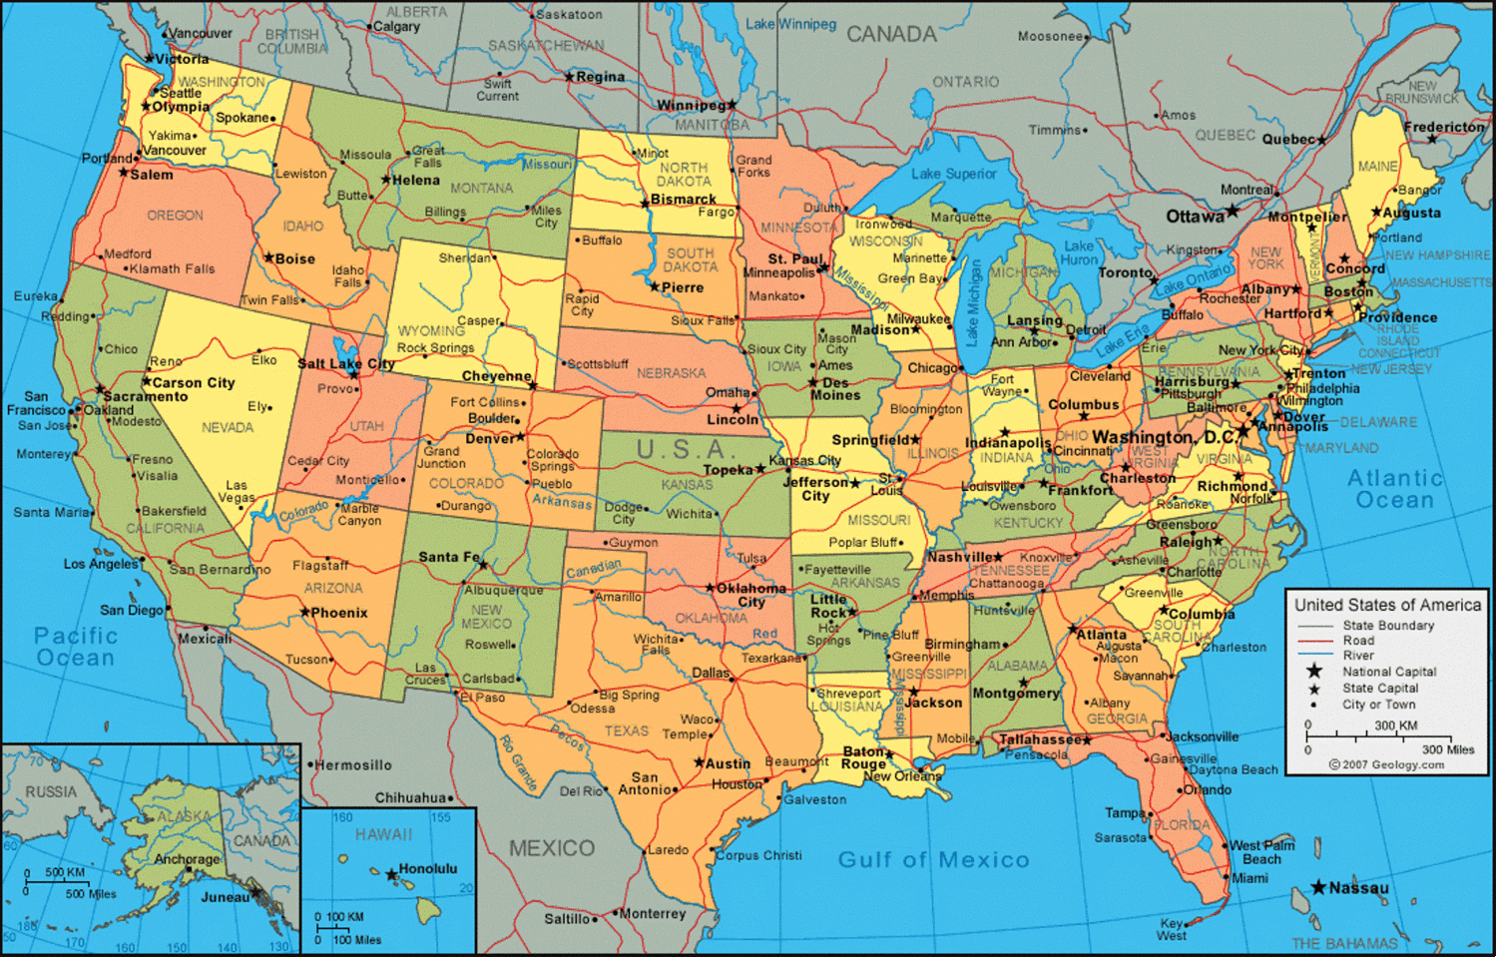
Judicial Locations
MUDAC 2020
How does location impact the American judiciary?

Slide 5
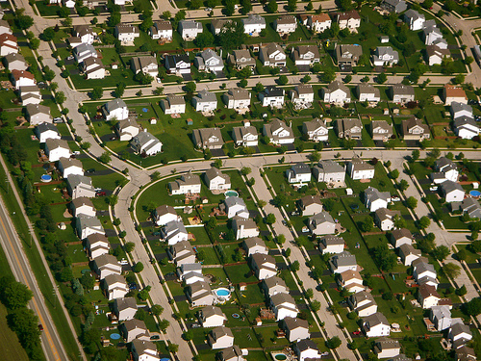
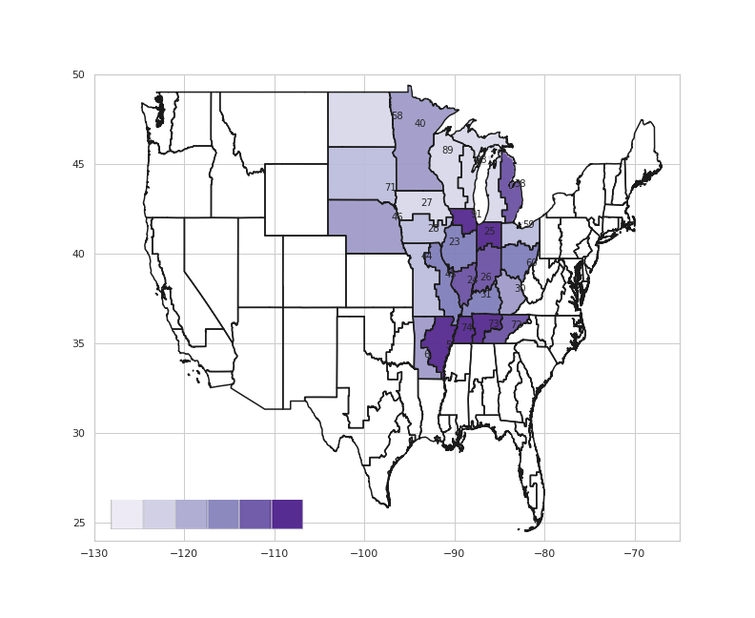
Cases per 100,000 State Residents
MUDAC 2020
Cases per 100,000 residents are clustered in
the lower Midwest and Western Appalachian states.
Western Tennessee is the highest, at 105
Western Wisconsin is the lowest, at 15

Slide 6
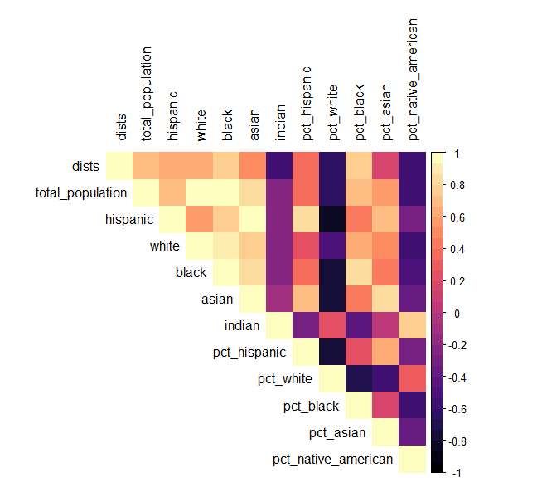
Demographics x Location
MUDAC 2020
How are Circuits and Districts Determined?
The number of districts in a state is highly negatively correlated with the state’s proportion of white residents R = -0.617
The number of cases heard by a district court is highly sensitive to its resident state’s Census population
In a univariate linear model, for every additional 100,000 residents, the court was projected to hear 50 new cases R² = 0.633

Slide 7
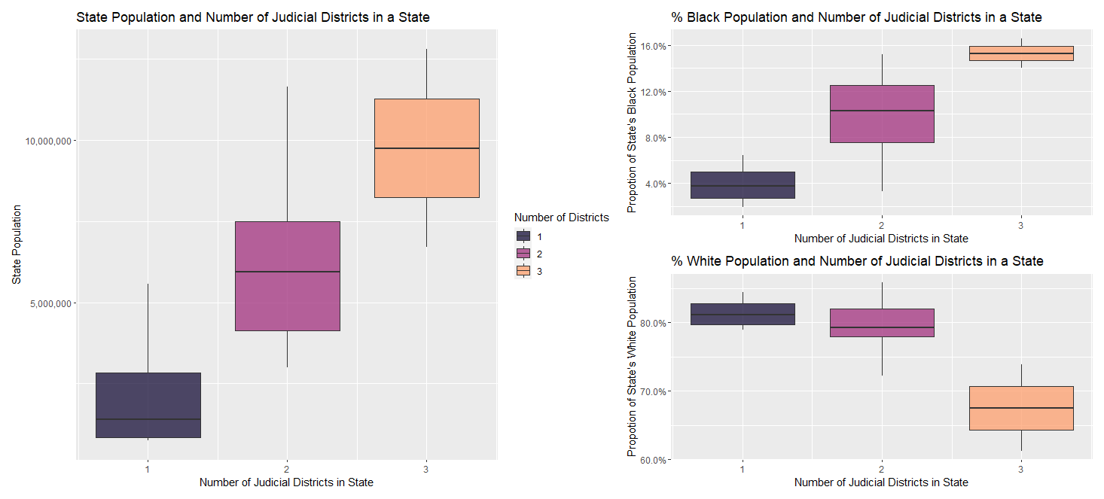
Race x Location
States with a higher proportion of Black residents tend to have more judicial districts.
Notes:
In Figure 1, to the left, we can see that states with more judicial districts tend to be more populous. In the 6th, 7th, and 8th circuits, these states are Illinois and Tennessee. The figures to the right show this distribution broken down by race, as is shows, states with a higher proportion of black residents tend to have more judicial districts.

Slide 8

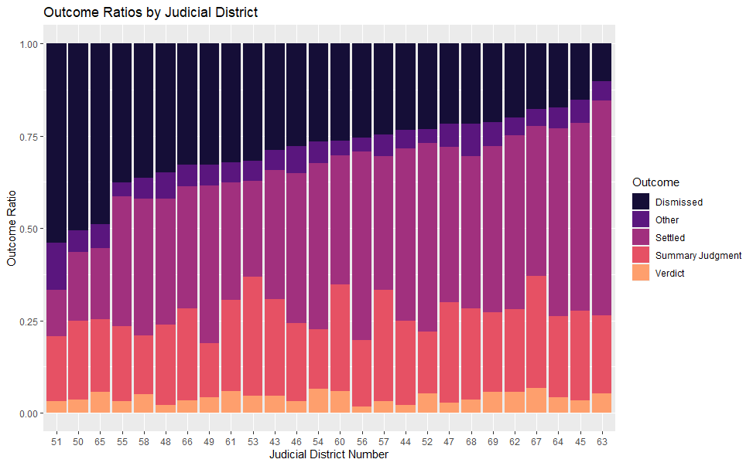
Outcomes x Location
MUDAC 2020
How do districts differ in adjudication?
When controlling for the number of cases heard, some districts dismissed 5x more of their cases than other districts
Districts with higher rates of dismissal tend to have a higher volume of cases
Highest rate of dismissal is in Western Tennessee, also the highest number of cases per capita

Slide 9
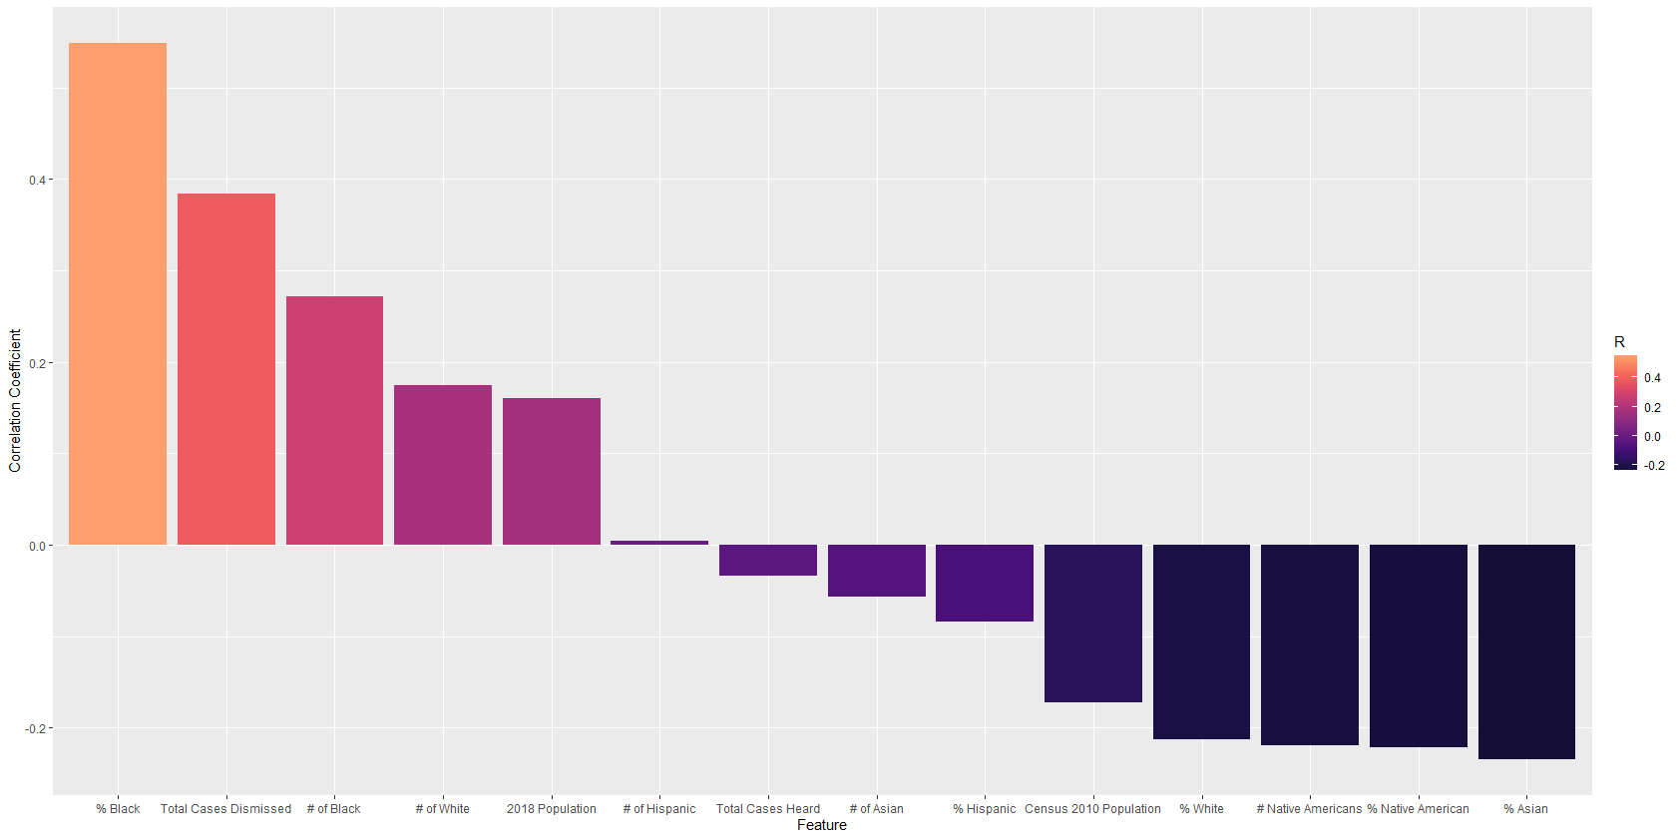
Correlation x Dismissal Rate
What do frequently dismissing courts have in common?

Slide 10

Judicial Decisions
MUDAC 2020
How do judges judge?

Slide 11

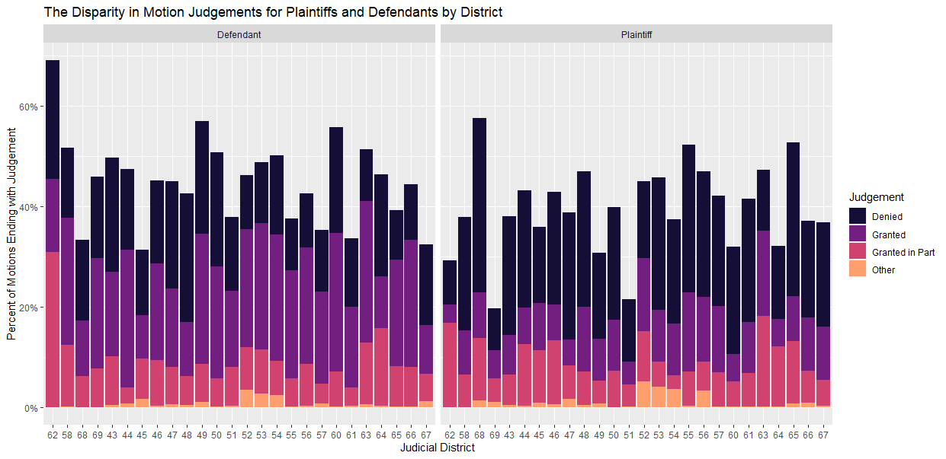
Decisions x Party
MUDAC 2020
Not all courts judge the same…
Typically, when Defendants file for a motion it is more likely to be granted than a Plaintiff filing a motion
Roughly 3x more appeals are granted from Defendants than Plaintiffs

Slide 12

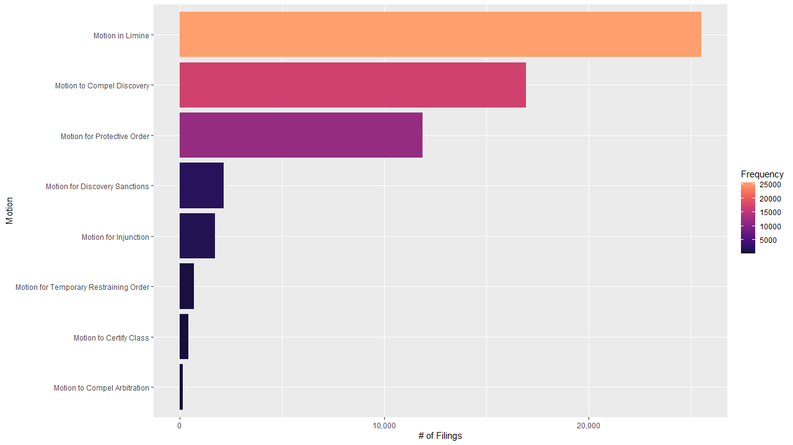
Frequency x Non-Terminating Motions
Which motions are filed the most often?

Slide 13
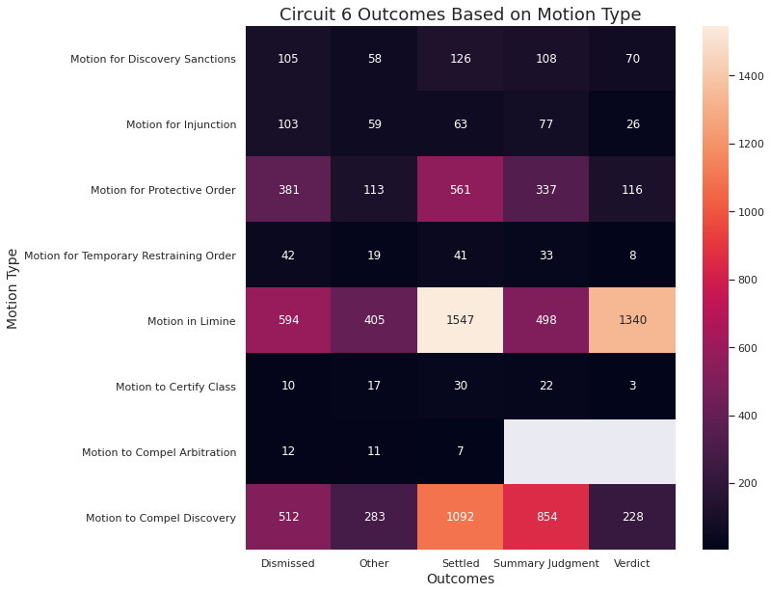
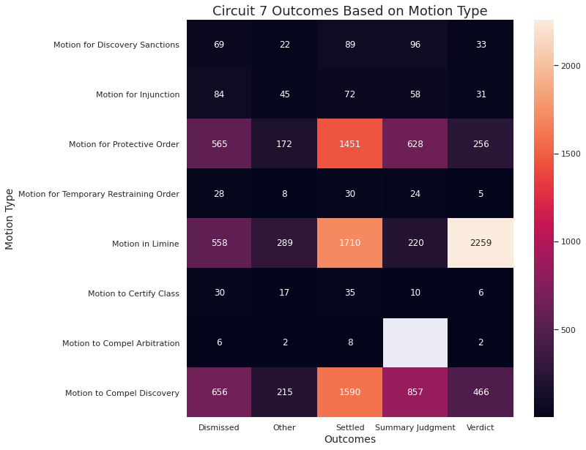
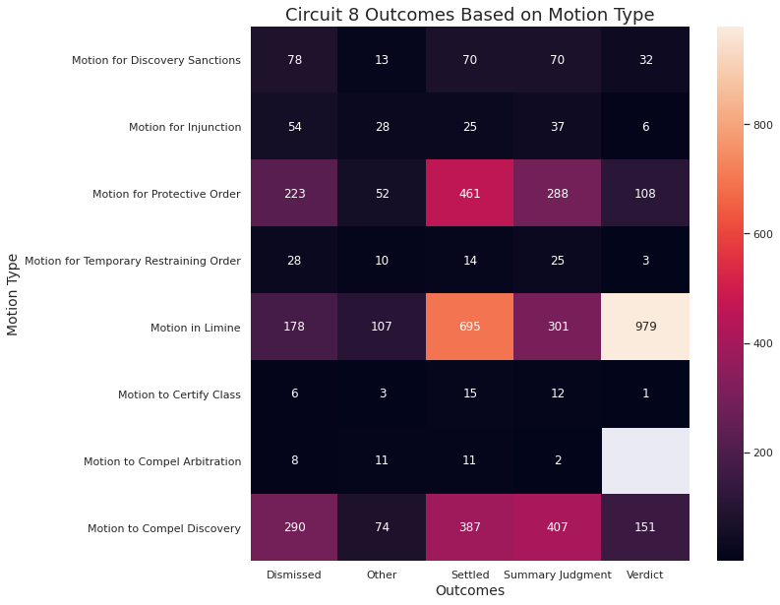
Motions x Outcomes
Motions in Limine result in more Verdicts, while Motions to Compel Discovery often yield settlements.

Slide 14

Predictive Analysis
MUDAC 2020
Can judgements of the court be predicted?

Slide 15

Background
MUDAC 2020
What does it mean to predict cases?
Knowing factors that are associated with oft-settled cases allows attorneys to allocate resources efficiently
Which cases should be settled?
Which should go to court?
Data does not show a case’s merits
Adjudication is rarely a zero-sum game

Slide 16
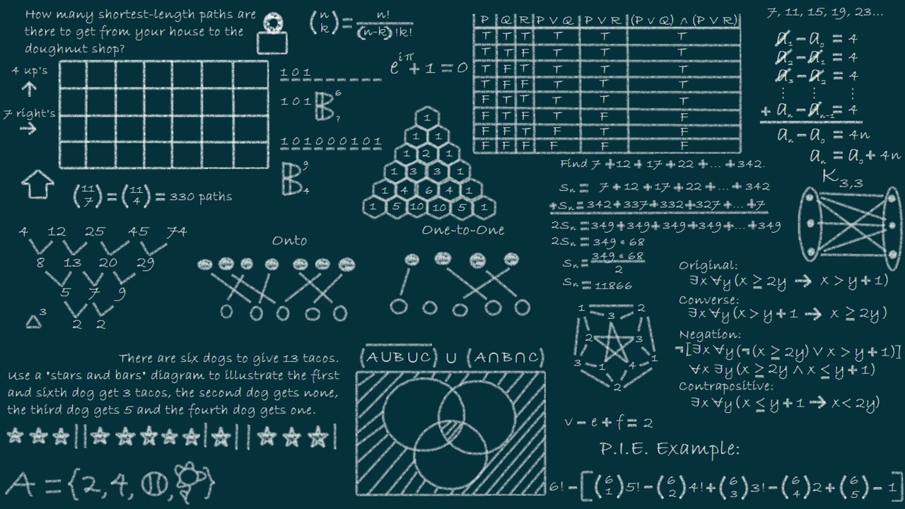
Model x Architecture
The Process
MUDAC 2020
Case, Location, and Demographic data are aggregated, transformed, and loaded into Model 1
Fitted Probabilities are then passed in conjunction with the data into Model 2
The Model
M1 Fitted Values
Our algorithm consists of 2 logistic regressions
One to predict the probability of a settlement
One to predict the probability of summary judgements
Case
Demographic
Location
Probability of Settlement
Case
Location
Probability of Summary Judgement
Demographic
Fitted Values

Slide 17

Model x Performance
MUDAC 2020
How did it perform?
How can it improve?
In 100 iterations of the model, we were able to achieve an overall accuracy of
73.24% on Summary Judgements
68.24% on Settlements
This performance beats the naïve classifier, thus showing worth as a viable model
Text analysis on case titles could find insights as differences in groups
Temporal analysis of when motions were filed relative to one another
Sentiment analysis on the written motions filed

Slide 18
Citations
Where did we get this information, data, & more?
“Median Household Income By State.” Median Household Income By State 2020, 2020, worldpopulationreview.com/states/median-household-income-by-state/.
“State Population By Race, Ethnicity Data.” State Population By Race, Ethnicity Data, www.governing.com/gov-data/census/state-minority-population-data-estimates.html.

